Slide 1
Unit 2
2a.Life Characteristics
2b. Microscopes
2c. Cell Structure
2d. Osmosis

Slide 2
Unit 2a.
Life Characteristics

Slide 3
Characteristics of Life
What makes something living?
Has an orderly structure
Produce offspring
Grow and develop
Requires energy
Expels waste / Respiration
Made of at least one cell
A cell in and of itself is considered a living thing because it performs all of these functions.
Notes:
3

Slide 4
Adjust to change in the environment involves. . .
Responding to Stimuli
Ex. Getting a shot (the stimulus) makes you flinch
Homeostasis = Regulation of organism’s internal environment to maintain conditions suitable for survival.
Ex: humans sweating and shivering
Adaptation = Inherited from generations (over time) that enables an organism to survive & reproduce

Slide 5
Chemical Compounds all living things share Carbohydrates
These are sugars
Provide energy & structure for living organisms
Examples: glucose, maltose, sucrose or starch

Slide 6
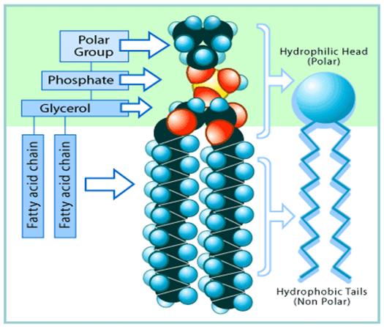
Chemical Compounds all living things share
Lipids
These are fats, oils, and waxes
The three major functions of lipids are
Energy storage & insulation
Structure for cell membrane development
Serving as a component of hormones and vitamins in the body.

Slide 7
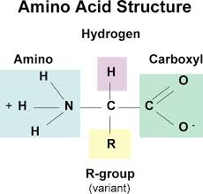
Chemical Compounds all living things share
Proteins
The five major functions of proteins are
Structure (example: collagen & keratin in animals)
Transport (example: hemoglobin in blood)
Hormones (example: insulin)
Defense (example: antibodies)
Enzymes (regulate chemical reactions and end in -ase. Example: lipase & lactase)
Proteins are made up of hundreds or thousands of smaller units called amino acids.

Slide 8
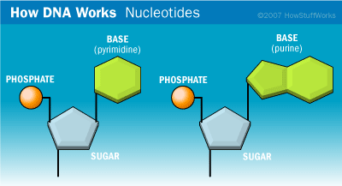
Nucleic acids
Is the genetic information that can be passed from parent to offspring.
Composed of Nucleotides that are made up of three parts
Nitrogenous Base
Monosaccharide
Phosphate group
Ex. are DNA and RNA

Slide 9
Unit 2b.
Microscopes

Slide 10
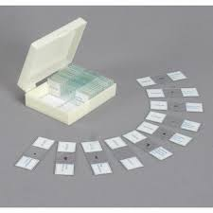
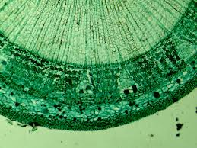
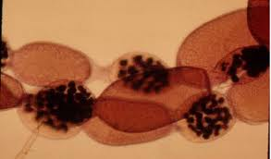
Types of Microscopes
Compound Light Microscopes
Magnify objects 1500 times

Slide 11
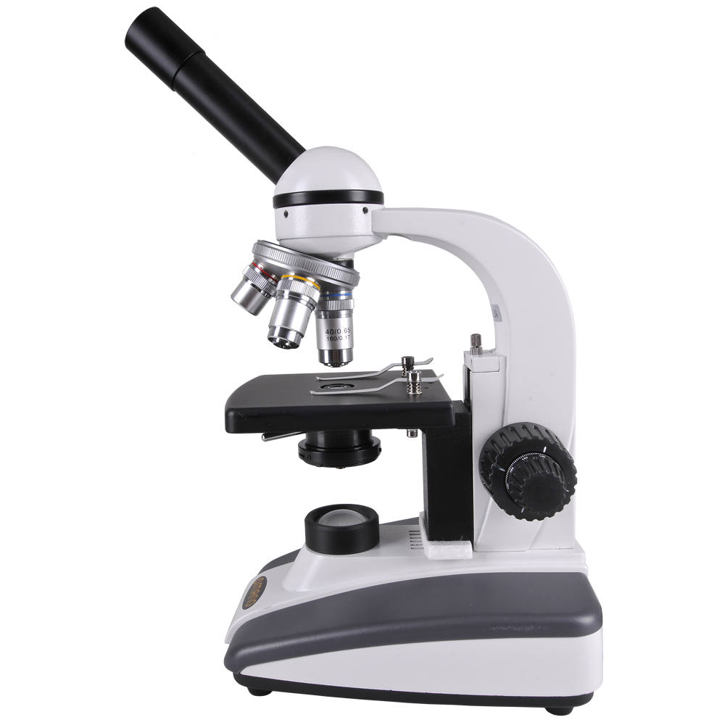
Compound or Light Microscope
Use compound lenses to magnify objects
Lenses bend or refract light to make object appear closer
Common magnifications:
40x, 100x, 400x

Slide 12
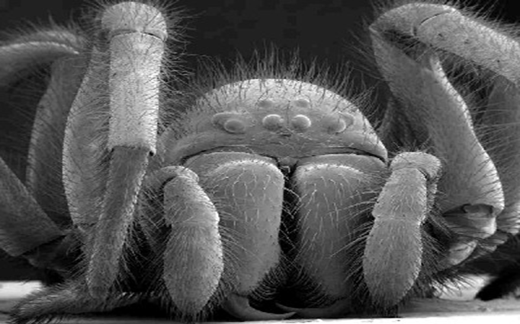
Types of Microscopes
Electron Microscopes
Uses electrons instead of light to magnify structure up to 500,000 times
SEM= Scanning Electron Microscope
Scans the surface of cells to learn 3-D shapes

Slide 13
Anatomy of a Microscope

Slide 14
Magnification
Your microscope has 3 magnifications:
Scanning
Low
High
Each objective will have the magnification written on it.
The ocular lens (eyepiece) has a magnification.
The total magnification is the ocular x objective

Slide 15
Magnification
 | Magnification | Ocular lens | Total Magnification
Scanning | 4x | 10x | 40x
Low Power | 10x | 10x | 100x
High Power | 40x | 10x | 400x

Slide 16
Focusing Specimens
1. ALWAYS start with the scanning objective.
The scanning is the shortest objective
Make sure the diaphragm is set to the largest opening
Use the Coarse Adjustment Knob to focus (biggest knob)
Do not use stage clips right away, try moving the slide around until you find something.
If you find an area then use the stage clips to anchor the slide.
DON’T SWITCH TO A HIGHER POWER UNTIL YOU HAVE FOUND A CLEAR VIEW.

Slide 17
Focusing Specimens to low power
2. Once you've focused on Scanning, switch to Low Power.
The low objective is the middle objective.
Use the Coarse Adjustment Knob to refocus (biggest knob)
If you need to refine your focus use the Fine Adjustment Knob (smaller knob)

Slide 18
Focusing Specimens to high power
3. Now switch to High Power.
(If you have a thick slide, or a slide without a cover, do NOT use the high power objective).
At this point, ONLY use the Fine Adjustment Knob (smallest) to focus specimens.
DO NOT use the Coarse Adjustment Knob (biggest)
If the specimen is too light or too dark, try adjusting the diaphragm.

Slide 19
Drawing a Specimen
1. Use pencil - you can erase and shade areas
2. All drawings should include clear and proper labels (and be large enough to view details).
Drawings should be labeled with the specimen name and magnification.
3. Labels should be written on the outside of the circle.
The circle indicates what you see when you look through the eyepiece, specimens should be drawn to scale
Ex: if your specimen takes up the whole viewing field, make sure your drawing reflects that.

Slide 20
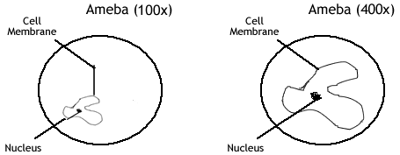

Slide 21
Unit 2c.
Cell Structure and Function

Slide 22
Two Types of Cells
Prokaryotes
NO NUCLEUS- DNA is floating freely inside cell!
Smallest cells / unicellular – made of one cell
No cellular organs (organelles)
Contains: DNA, ribosomes, cytoplasm, plasma membrane, cell wall, capsule, flagella/cilli & pilli
Ex: bacteria

Slide 23
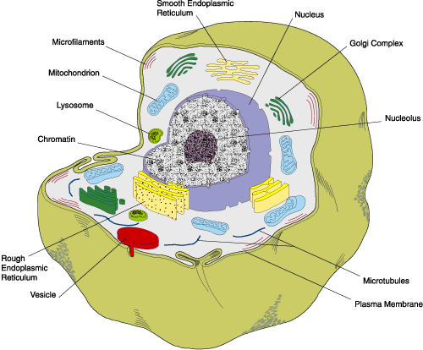
Eukaryotes
DNA is held in the nucleus
Contains organelles
Eukaryotic cells are MUCH BIGGER then Prokaryotic cells.
Can be multicellular or unicellular
Ex: animals, plants, fungi, protist

Slide 24
Discovery of Cells
Robert Hooke
British scientist who first observed and named cells
studied bark of trees in 1665
Virchow
Russian Scientist came up with the Cell Theory:
All organisms are composed of one or more cells
The cell is the basic unit of organization
All cells come from preexisting cells

Slide 25
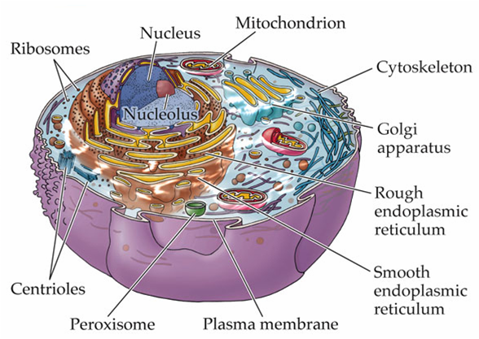
What are Organelles?
Tiny organs of a Eukaryotic cell
Most organelles have an outer membrane layer.
Membranes are made of lipids
The lipid membranes keep the inside of the organelle separate from the outside. (like a wall)
Each Organelle has a job to do.
There are a lot of different organelles.

Slide 26
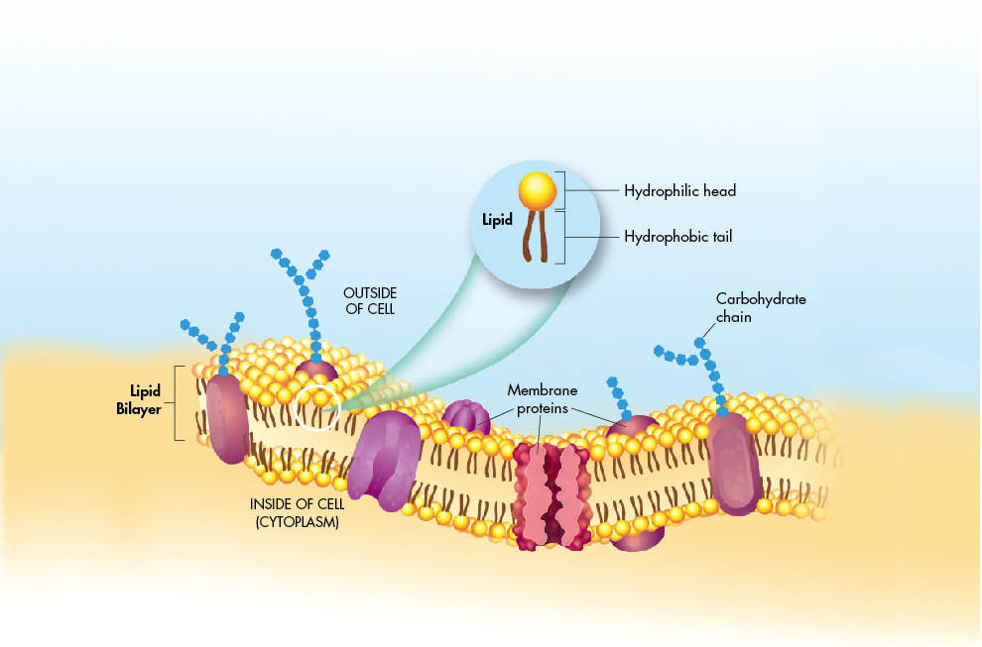
Plasma membrane
Structure and Security
Surrounds the entire cell
Made of Phospholipids and Proteins

Slide 27
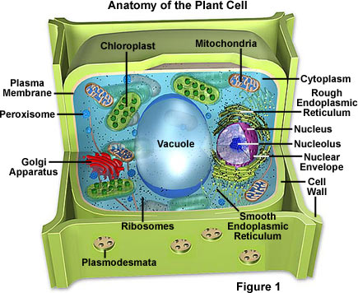
*Cell Wall- (Plants Only)
Used for structure (Helps plants stand up)
Surrounds the entire cell (even the plasma membrane)
Like a solid wall

Slide 28
Cytoplasm and Cytoskeleton- Work Area (Not really an organelle)
Cytoplasm- The fluid that makes up the inside of the cell.
Organelles and proteins work in this space.
Cytoskeleton- made of proteins and used as tracks for the movement of organelles.

Slide 29
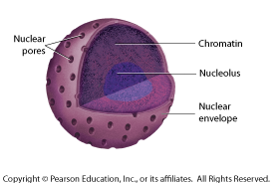
Nucleus- main office
Where the DNA is kept.
DNA is the blueprint for making proteins
Ribosomes are made in the nucleolus.

Slide 30
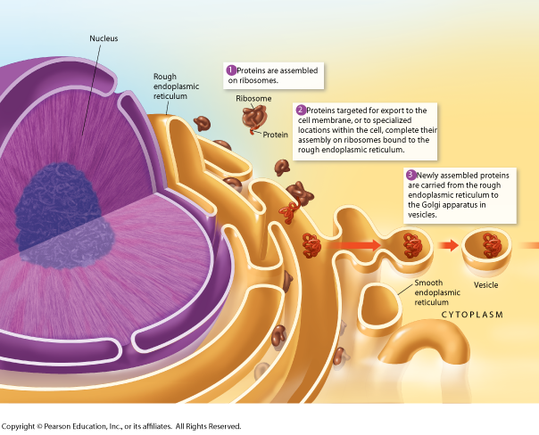
Ribosomes- worker-bees
Created in the nucleus- are in fact RNA
They help make proteins
Can be attached to ER or free floating
Attached to ER make proteins to be shipped out of the cell
Free floating make protein for the cell
In Eukaryotes and Prokaryotes

Slide 31
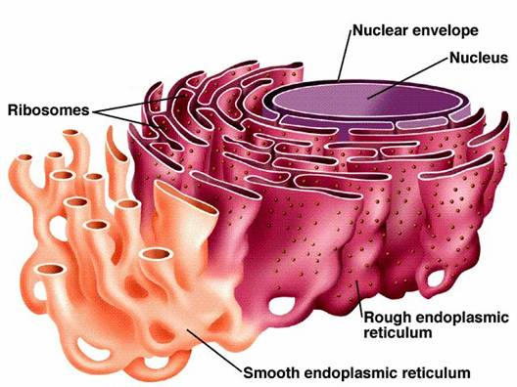
Endoplasmic Reticulum (ER)
Two Types
Rough ER- Finishes protein- Specialized proteins are completed here and shipped off to other parts of the cell.
Located next to the nucleus.
Where ribosomes are located.
Smooth ER- Makes Lipids / Breakdown toxins

Slide 32
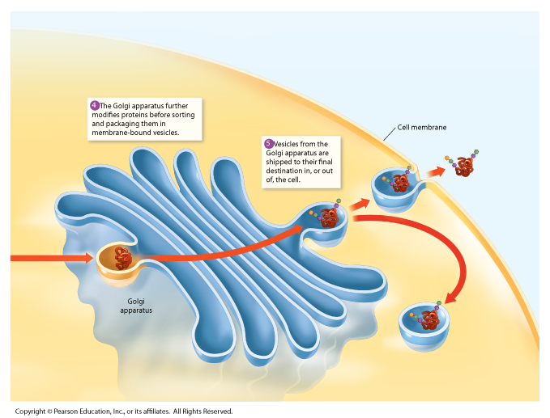
Golgi Complex
Package & ships proteins to other parts of the cell.
Golgi receives and sends proteins in objects called Vesicles.

Slide 33
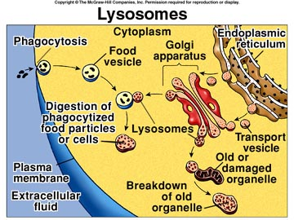
Lysosomes
recycling & waste removal
Can break up food particles into smaller parts for cell to use.
Can break down old useless organelles

Slide 34
*Chloroplast (Plants Only)
Converts light into Carbohydrates.
Carbohydrates are used by the cell for energy!

Slide 35
Mitochondria
Provides cell with energy!
Does this by breaking down Carbohydrates.

Slide 36
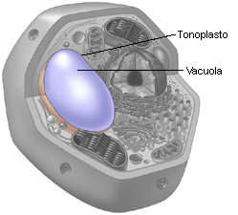
Vacuole
Stores water and waste/toxins
In plants, puts pressure against the cell wall to keep cell rigid.

Slide 37
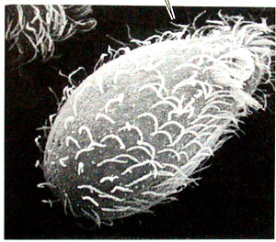
Cilia & Flagella
Cillia - catches particles
Flagella - used for movement.

Slide 38
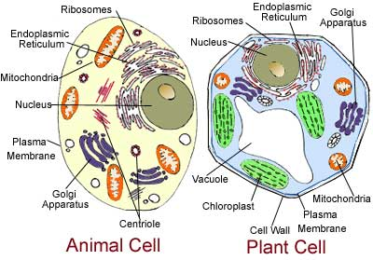
Comparison of Animal and Plant cells
Lysosome
Fungus-like
Vesicle
Plant-like
Animal-like

Slide 39
Unit 2d.
Osmosis

Slide 40
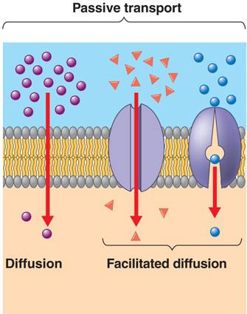
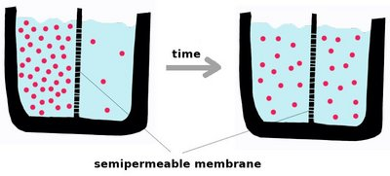
How stuff gets into and out of the cell
Passive Transport
Particles can enter and exit the cell without the use of energy.
Carrier Proteins move small particles into the cell.
Diffusion moves very small particles from an area of high concentration to an area of lower concentration.

Slide 41
Active Transport
Particles can enter and exit the cell with the use of energy
Endocytosis (“in to” the cytoplasm)
The process where a cell will take in foreign substances.
This is done by the cell wrapping its cell membrane around a substance and literally “taking it in.”
Exocytosis (“exit” the cytoplasm)
The process where a cell will release substances from itself.
This is done by vesicles fusing with the cell’s cell membrane.

Slide 42
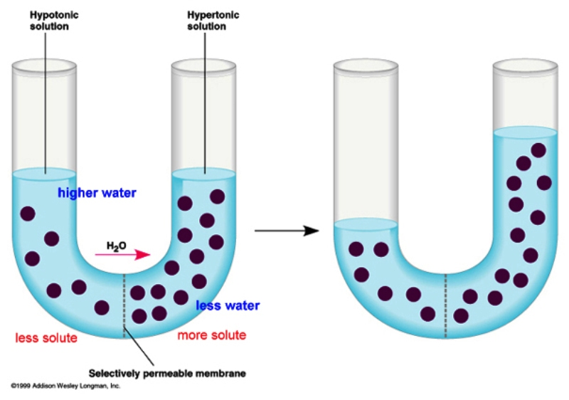
How water moves in and out of a cell.
There must first be a Concentration gradient!
Difference in concentration of stuff across a space
Diffusion will continue until there is no concentration gradient - - equilibrium has occurred.
Osmosis
The diffusion of water.
Water molecules moving from an area of high concentration to an area of low concentration

Slide 43
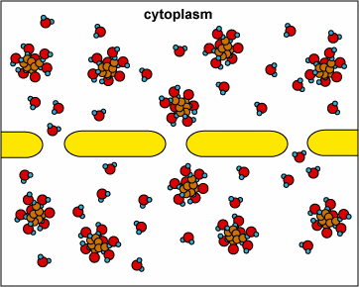
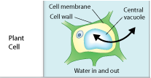
Three types solutions
Isotonic =
Concentration of non-water molecules outside the cell is the same as the concentration of non-water molecules inside the cell. (i.e. equal water inside and outside of cell)
Water will move in and out of cell at same speed.
Cell keeps its shape

Slide 44
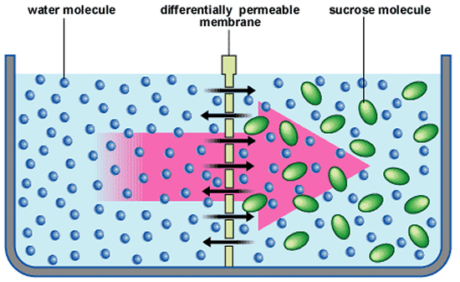
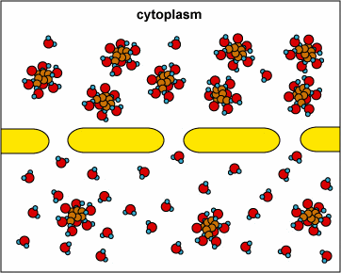
Hypotonic =
High concentration of non-water molecules inside the cell (i.e. less water inside)
Low concentration of non-water molecules outside of the cell (i.e. more water outside)
Osmosis will cause water to move into the cell
Cells will get bigger . . . and explode!!!

Slide 45
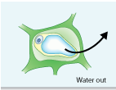
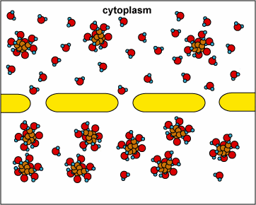
Hypertonic
High concentration of non-water molecules outside of the cell (i.e. Less water outside)
Low concentration of non-water molecules inside the cell (i.e. More water inside)
Osmosis will move the water out of the cell
Cell will shrink

Slide 46
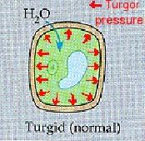
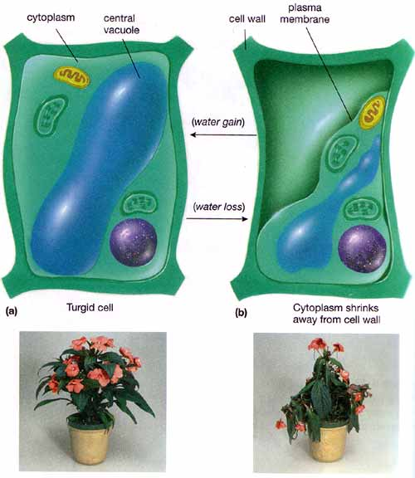
Osmosis in Plant cells
Turgor Pressure
Pressure that builds inside of a cell as the result of osmosis
Helps plant cells to keep the plant “standing up.”
Plasmolysis
Loss of water resulting in a drop in turgor pressure
Causes plant cells to wilt

