Slide 1
Unit 3
Photosynthesis and Cell Respiration

Slide 2
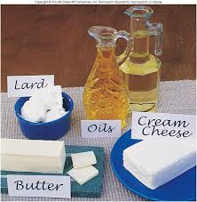
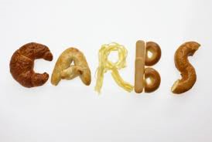
Chemical Energy
All carbon-based molecules in food store chemical energy in their bonds.
Carbohydrates and lipids are the most important energy sources
  Energy is only available once the molecules are broken down

Slide 3
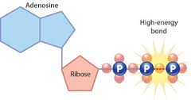
Adenosine Triphosphate (ATP)
Molecule that transfers energy from the breakdown of food to cell processes
Function
  Building molecules
  Moving materials by active transport

Slide 4
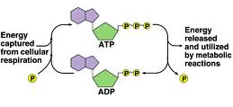
Energy in ATP
Energy is released when a phosphate group is removed form the molecule
The bond holding the third phosphate is unstable and easily broken to form ADP

Slide 5
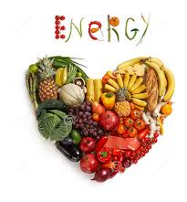
ATP in Food
Food that we eat does not contain ATP that our cells can use
The food must be digested and broken into smaller molecules.
Different foods provide different amounts of ATP.

Slide 6
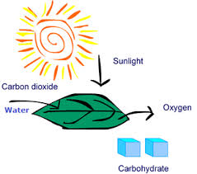
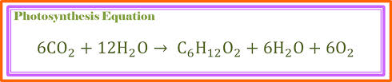
Photosynthesis
Conversion of light energy into chemical energy (carbohydrates = sucrose and starch) inside the chloroplast
Light-dependent reaction (needs light) and light-independent reaction (doesn’t need light)

Slide 7
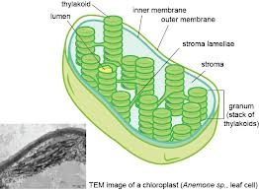
Chlorophyll
A green pigment molecule in the chloroplast that absorbs the light energy
Two types: chlorophyll a and chlorophyll b
  Absorb mainly red and blue light

Slide 8
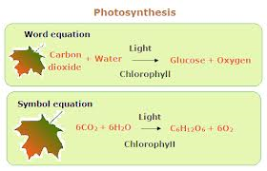
Rate of Photosynthesis
    Measured by production/release of oxygen or uptake of carbon dioxide or increase of biomass

Slide 11
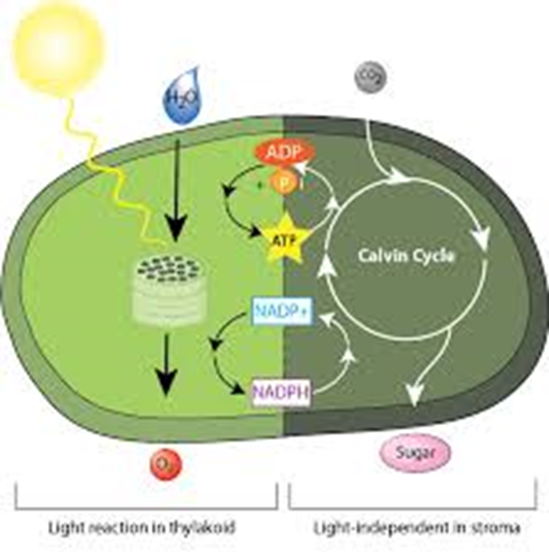
Light- Dependent Reaction
Takes place within thylakoid membrane
Water and sunlight are needed

Slide 12
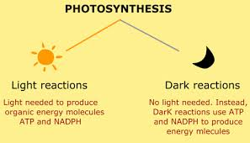
Light- Dependent Reaction
Process
Chlorophyll absorbs energy from sunlight.
Energy transferred along thylakoid membrane.
H₂O molecules broken down. O₂ released.
Energy carried along thylakoid membrane transferred to ATP.

Slide 13
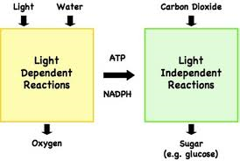
Light- Independent Reaction
Uses energy from the light-dependent reaction to make sugars (carbohydrates = glucose)
Occur in the stroma of chloroplasts
CO₂ is needed.

Slide 14
Light-Independent Reaction Process
CO₂ is needed to build larger molecules. Energy is needed from the light-dependent reaction.
A molecule of simple sugar is formed, usually glucose (C₆H₁₂O₆), to store some of the energy that was captured from sunlight.

Slide 15
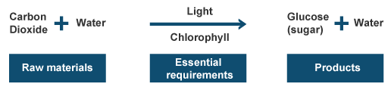
Photosynthesis Reaction

Slide 16
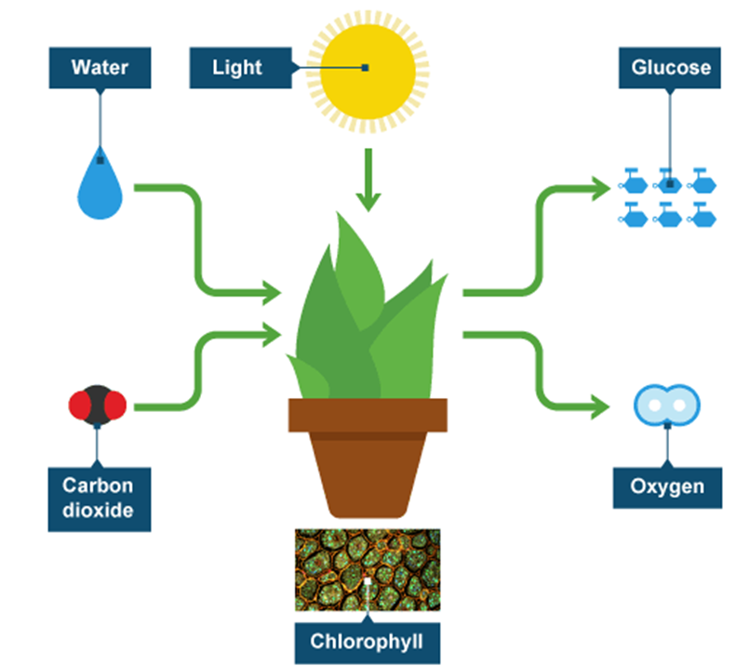
Photosynthesis Reaction

Slide 17
Purpose
Plants make their own food.
  Through PHOTOSYNTHESIS
  Inside the chloroplast
Eukaryotes break down molecules from food to produce energy, or ATP
  Through CELLULAR RESPIRATION
  Inside the mitochondria

Slide 18
Photosynthesis and Cellular Respiration
Photosynthesis:
6CO₂ + 6H₂O + light energy → C₆H₁₂O₆ + 6O₂
Cellular Respiration:
C₆H₁₂O₆ + 60₂→ 6H₂O + 6C0₂

Slide 19
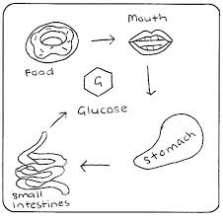
Energy from Food
Mitochondria cannot directly make ATP from food.
Foods are broken down into smaller molecules like glucose (C₆H₁₂O₆)

Slide 20
Three Main Steps
Glycolysis- 2 ATP made
Krebs cycle- 2 ATP made
Electron transport chain (ETC) – 32 ATP made
One glucose = 36 ATP

Slide 21
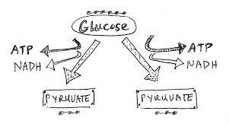
Glycolysis
Splits glucose into two three-carbon molecules and makes 2 ATP
Takes place in cell’s cytoplasm
Anaerobic: Doesn’t need Oxygen.
3-Carbon Molecule
3-Carbon Molecule

Slide 22
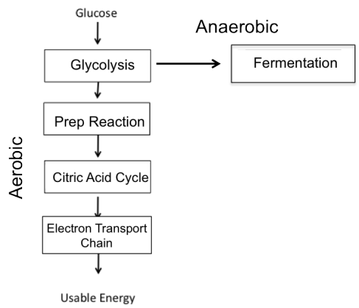

Slide 23
Is Oxygen Present?
Yes (Aerobic)? CELLULAR RESPIRATION
No (Anaerobic)? FERMENTATION

Slide 24
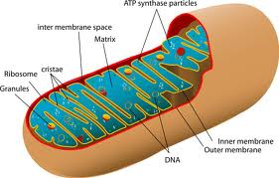
Cellular Respiration
Releases chemical energy from sugars and other carbon-based molecules to make ATP when oxygen is present.
Aerobic process
  Needs Oxygen to take place
Occurs in mitochondria.

Slide 25
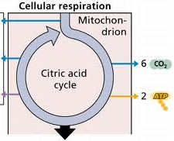
Krebs Cycle
3-carbon molecule from glycolysis are broken down
Occurs in matrix of mitochondria
2 ATPs made, Energy-carrying molecules transferred to Electron Transport Chain
Energy- Carrying Molecules
Krebs
Cycle

Slide 26
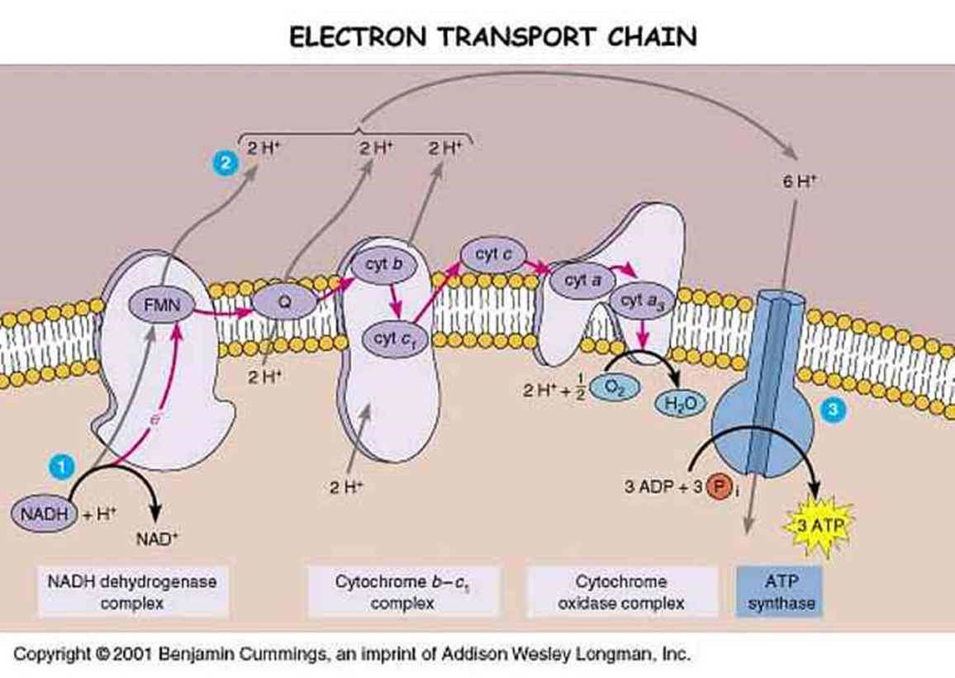
Electron Transport Chain
Energy-Carrying molecules from Krebs Cycle used to create ATP
32 ATP created
Occurs in inner mitochondrial membrane

Slide 27
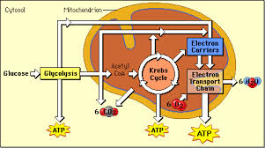
Cellular Respiration Overview

Slide 29
Anaerobic Respiration
NO OXYGEN
Only 2 ATP (from Glycolysis)
Glycolysis and then fermentation
Fermentations is just a way to get rid of the 3-carbon molecule
End products vary
Takes place in the cytoplasm

Slide 30
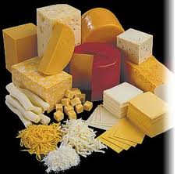
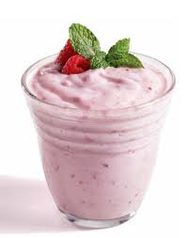
Lactic Acid Fermentation
Used by bacteria and our muscles!
Turn the 3-carbon molecule into lactic acid
NO NEW ENERGY ☹
Makes cheese and Yogurt!!

Slide 31
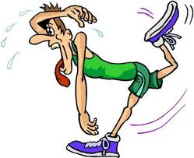
Lactic Acid Fermentation
Reason why our muscles get tired when we use them a long time.
Oxygen Debt- we owe our body oxygen to get rid of the lactic acid

Slide 32
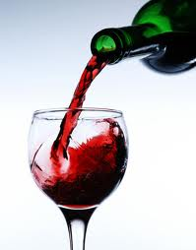
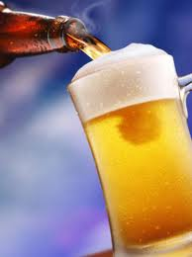
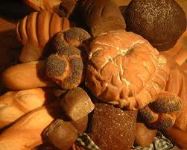
Ethanol Fermentation
Used by yeast
Turns pyruvate into ethanol and Carbon dioxide
NO NEW ENERGY ☹
Used to make wine, beer and bread!!

Slide 33
Which would you rather do?
Aerobic makes 36 ATP
Anaerobic makes 2 ATP
As long as oxygen is around, you will always choose Aerobic. Anaerobic is only there so we organisms can survive if they are in an environment without oxygen (or our muscles can keep working when they run out of oxygen)

