Slide 1
Unit 5: DNA-RNA-Proteins
Biomolecules: Nucleic Acids and Proteins

Slide 2
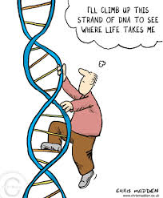
What is DNA?
A complex biomolecule (nucleic acid) that stores all of the cellular information in form of a code to make proteins (Genetic code)
Has complete instructions for making all proteins for ALL organisms
Located in the nucleus and
self-replicates
DNA= Deoxyribonucleic Acid
Genetic material for life and is
universal to all life

Slide 3
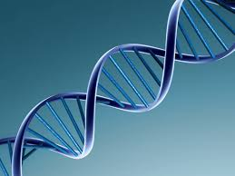
History of DNA Structure
Scientists Watson & Crick developed a model of DNA structure
proposed that sugar-phosphate backbone on the outside and bases on the inside
DNA strands are complementary: they fit together and are opposite of each other.
DNA is a double helix
Two strands of DNA wind around each other like a twisted ladder.

Slide 4
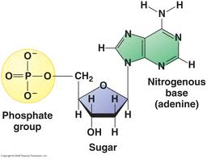
Structure of DNA
Small subunits that make up DNA are called nucleotides
Each nucleotide has three parts:
A phosphate group
A simple sugar (carbohydrate) called deoxyribose
A nitrogen-containing base (nitrogenous base = A, T, C & G)
Phosphate group and deoxyribose make up backbone

Slide 5
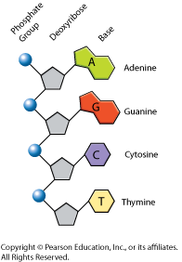
Nitrogen-Containing Bases
Two types of nitrogenous bases
Purines = A & G (double ring structure)
Pyrimidines = T & C (single ring structure)
4 different nucleotides, only differ in nitrogenous bases.
A= adenine
G= guanine
C=cytosine
T=thymine

Slide 6
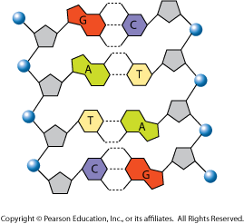
Base Pairing Rules
DNA molecule is Anti-parallel due to the Complementary bases bonding in the middle
Adenine (A) binds to Thymine (T)
Contains two hydrogen bonds between the bases
Cytosine (C) binds to Guanine (G)
Contains three hydrogen bonds between the bases
Explains Chargoff’s theory:
# of A = # of T
# of C = # of G
Example: 20 % of DNA is A
% of T = ?
% of G = ?
% of C = ?

Slide 7
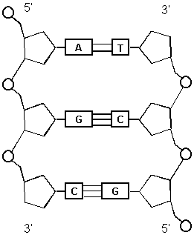
DNA Characteristics
DNA is a double helix structure
DNA model is called Anti-parallel
Each strand runs in opposite direction - five prime to three prime (5’ to 3’)
DNA has complementary base pairing
Contains Covalent bonds and Hydrogen bonds
Contains Nucleotides
Nitrogenous bases = C, G, T & A
Purines & Pyrimidines
Phosphate group
Deoxyribose sugar

Slide 8
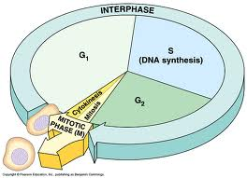
DNA replication
DNA self-replicates by Semi-Conservative
Produces two copies of DNA that each contains one strand of the original strands and one new strand
Process where DNA is copied during the cell cycle (Interphase)
occurs during S phase of Interphase of the cell cycle

Slide 9
DNA in Eukaryotes & Prokaryotes
Eukaryotes
Eukaryotic DNA is in the form of chromosomes
Replication occurs in the nucleus
Eukaryotes can begin self-replicating at any origin on the chromosome
Self-replicates in a five to three prime direction
Prokaryotes
Prokaryotic DNA is in the form of a ring
Replication occurs in the cytoplasm because the DNA is floating free in the cell
has to begin self-replicating at the Origin of Replication.
Self-replicates in a five to three prime direction

Slide 10
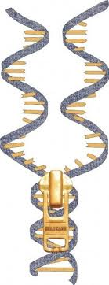
The DNA Replication Process
Replication begin at the origin. (different places for eukaryotes & prokaryotes)
Unzipping of the DNA molecule occurs by the action of the enzyme Helicase (this enzyme breaks the Hydrogen bonds between nitrogenous bases)
Helicase creates a replication fork and provides the two original strands as templates to create two new strands by means of semi-conservative replication.

Slide 11
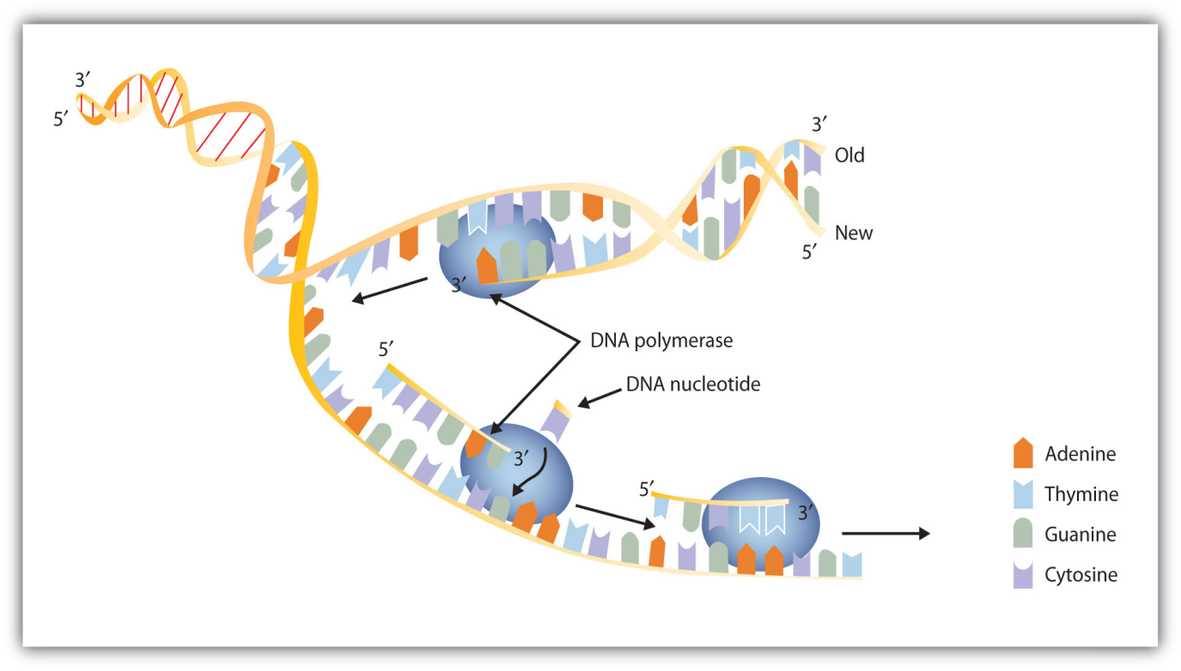
The DNA Replication Process
3. The enzyme Primase adds a Primer at the replication fork to begin the replication process (A primer is made of RNA nucleotides that will attach to the DNA strand)
4. DNA polymerase III is an enzyme that joins individual nucleotides to the growing DNA strand to produce a new strand of DNA that is complementary to the original DNA strand.
New bases are added in a 5’ to 3’ and according to base pairing rules:
A with T
G with C

Slide 12
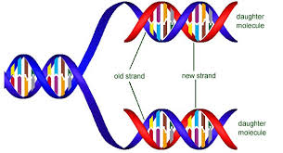
The DNA Replication Process
5. DNA polymerase I removes the primer and replaces it with DNA nucleotides to complete the self-replicating process.
The primer is made of RNA nucleotides so those can’t be left in the DNA molecule
Two identical DNA molecules result. This is Semi-Conservative Replication (Produces two copies of DNA that each contains one strand of the original strands and one new strand)

Slide 13
The DNA Replication Process
DNA is composed of two anti-parallel strands which are self-replicating at the same time in a 5’ to 3’ direction
Leading strand – being produced continuously and being replicated towards the replication fork
Lagging strand – being produced discontinuously and being replicated away from the fork

Slide 14
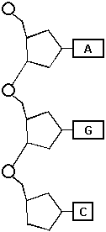
What is RNA?
RNA = Ribonucleic Acid
A complex biomolecule (nucleic acid) that transfers information from DNA to make proteins
Single strand of nucleotides
RNA is a complementary copy of DNA used to make proteins.

Slide 15
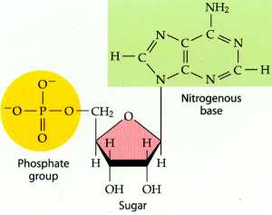
RNA nucleotides
Small subunits that make up RNA are called nucleotides
Each nucleotide has three parts:
A phosphate group
A simple sugar (carbohydrate) called ribose
A nitrogen-containing base (nitrogenous base = A, C , G & U)
U= uracil (Replaces T)
A= adenine
G= guanine
C=cytosine
Complementary base pairs → A-U & C-G
Phosphate group and ribose make up backbone of RNA

Slide 16
3 Types of RNA
mRNA → messenger RNA
carries a copy of the DNA’s instructions (code) for the creation of proteins.
rRNA → ribosomal RNA
Makes up ribosomes - structures where proteins are assembled.
tRNA → transfer RNA
carries amino acids to the ribosome and matches them to the coded mRNA message.

Slide 17
Transcription
Formation of a mRNA strand which is complementary to a DNA strand
Making mRNA from DNA in a 5’ to 3’ direction
Inside the nucleus of a Eukaryotic cell
Inside the cytoplasm of a Prokaryotic cell
Transcription using the enzyme RNA polymerase

Slide 18
Transcription Process
RNA polymerase is an enzyme that separates the two DNA strands and combines to a portion of DNA that codes for a specific protein.
uses only one side of DNA to create a single strand of RNA.
Uses only DNA as a template to lay RNA nucleotides in a specific order according to the DNA code.

Slide 19
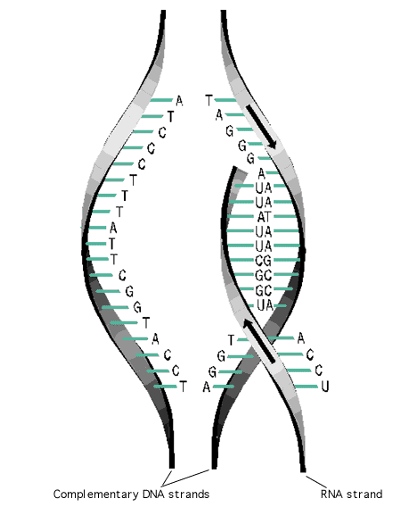
Transcription Process
2. When the DNA opens a transcription bubble occurs exposing the DNA nucleotides
3. New bases are added to a growing mRNA strand in a 5’ to 3’ direction according to the complementary base pairing rules:
DNA = A T T C G C A T T
RNA = U A A G C G U A A
4. A sequence of DNA nucleotides (terminator) will end the process of transcription and cause RNA polymerase and the mRNA strand to detach

Slide 20
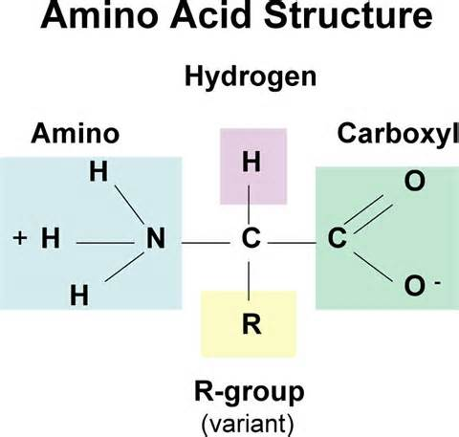
Amino Acids
Basic building blocks of proteins
There are 20 common amino acids
Amino acids are connected by peptide bonds
A chain of amino acids is called a polypeptide chain
The creation of the polypeptide chain (protein) occurs in ribosomes
Free Ribosomes – create proteins for
the cell
Bounded Ribosomes – create proteins to be
shipped out of the cell

Slide 21
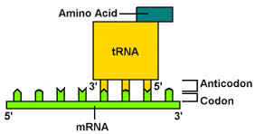
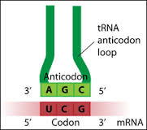
Codon & Anticodon
Every 3 nitrogenous bases on the mRNA codes for 1 amino acid. This is called a codon.
tRNA carries the amino acids to the ribosome and matches them to the mRNA by having an anticodon
Anticodon is a set of three nucleotides on tRNA that is complementary to a mRNA codon
Example: Codon GGG pairs with Anticodon CCC

Slide 22
Translation
Process that converts or translates the information in a sequence of nitrogenous on the mRNA into a chain of amino acids to create a protein
Translation occurs in a 5’ to 3’ direction
The chain of amino acids is called a polypeptide chain
The polypeptide chain codes for a protein from a gene on the DNA molecule

Slide 23
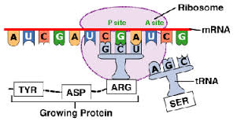
Translation Process
Translation begins at the start codon on the mRNA. The start codon is always AUG
2. tRNA delivers the first amino acid to the ribosome to begin to produce the polypeptide chain
tRNA contains an anticodon that binds to the mRNA’s codon and carries one kind of amino acid.

Slide 24
Translation Process
3. The elongation of the polypeptide chain occurs when the next tRNA brings another amino acid to the ribosome.
4. The polypeptide chains continues to grow until a stop codon appears on the mRNA.
5. The tRNA brings the corresponding amino acid to stop the process of translation. Now the newly formed polypeptide (protein) is then released.

Slide 25
Determining Protein Sequence

Slide 26
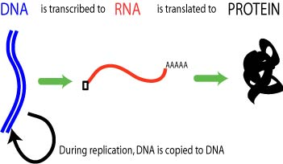
The Central Dogma
DNA→ mRNA→ Protein
The creation of mRNA from DNA is called Transcription
The creation of a protein from mRNA is called Translation

Slide 27
Comparing DNA and RNA
 | DNA | RNA
Type of Sugar
Number of Strands
Nitrogenous Bases
Location in Cell

Slide 28
Mutations
A Mutation is a permanent change of the nucleotide sequence of the genome of an organism
Genome is the complete DNA sequence of an organism
Typically happens during replication if it affects a single gene
If a mutation is not fixed, if may permanently change an organism’s DNA

Slide 29
Effects of Mutations
Genetic diseases
Cancer
New genetic traits
No harm at all

Slide 30
Manipulating DNA
How can we manipulate DNA?
Literally cut it into pieces.
Done through proteins called restriction enzymes
What can it be used for?
Paternity testing
Criminal Investigation
Genetic Engineering
Cloning

Slide 31
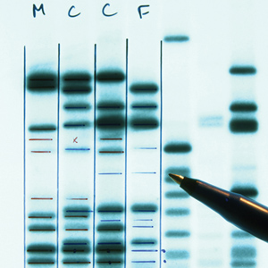
Paternity and Criminal Investigations
Cut up fragments of DNA are put into a gel electrophoresis.
Depending on how big the segment of DNA, the further down the gel a fragment of DNA will move.
Then compare one persons DNA to another persons to see if they’re related.

Slide 32
Genetic Engineering
Cut up fragments of DNA with specific genes can be added to DNA of a fertilized egg.
This can give rise to organisms with new traits.
Example: Mice that can glow

Slide 33
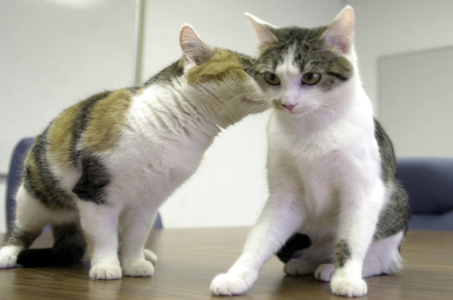
Cloning
Theoretically, any organism can be cloned to make a genetically identical organism.
These two cats are clones but, they look different. This is because different genes on the same DNA can be activated by the different environments the organism grew up in.

Slide 34
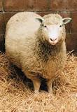
Dolly the Sheep (1996)
She was the first mammal to be cloned from an adult cell.

